Slide 1
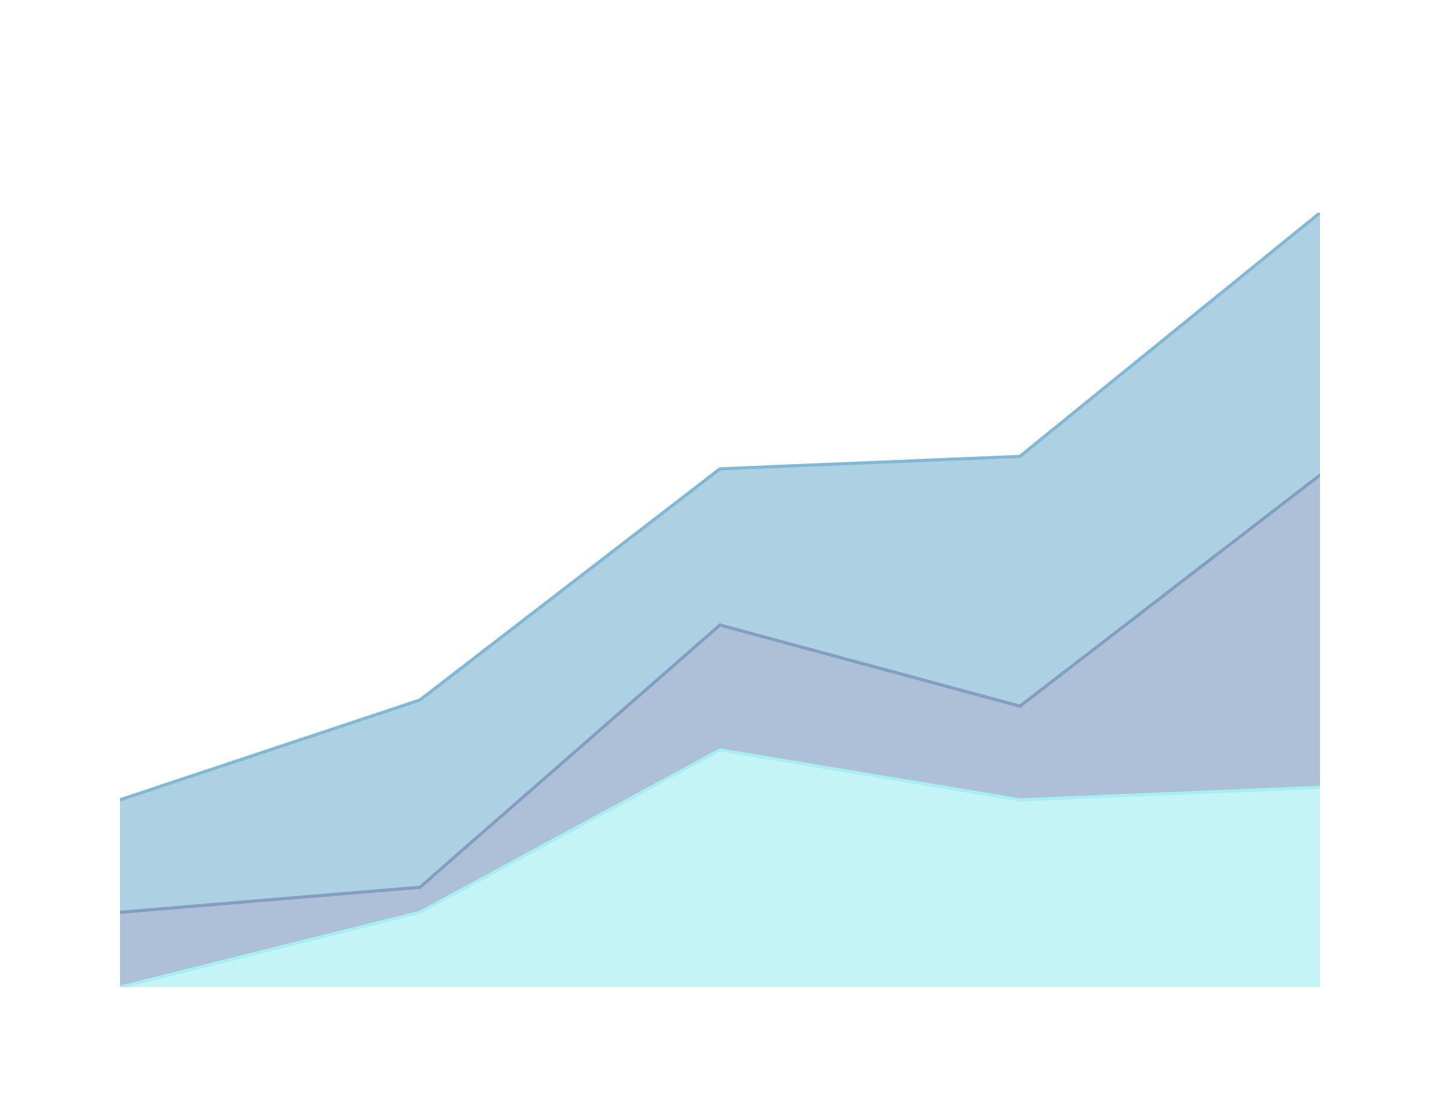
DUBAIE REAL ESTATE
BY: EMAN ELBENDARY

Slide 2

DUBAI REAL ESTAT DATA
In what building type should i invest
What is the trend of rental prices over time in a specific location?
how to increase the company income

Slide 3
DUBAI REAL ESTAT DATA
Address: Full address of the property.
Rent: The annual rent price in AED.
Beds: Number of bedrooms in the property.
Baths: Number of bathrooms in the property.
Type: Type of property (e.g., Apartment, Villa, Penthouse).
Area_in_sqft: Total area of the property in square feet.
Rent_per_sqft: Rent price per square foot, calculated as Rent divided by Area_in_sqft.
Rent_category: Categorization of the rent price (Low, Medium, High) based on thresholds.
Frequency: Rental payment frequency, which is consistently 'Yearly'.
Furnishing: Furnishing status of the property (Furnished, Unfurnished).
Purpose: The purpose of the listing, typically 'For Rent'.
Posted_date: The date the property was listed for rent.
Age_of_listing_in_days: The number of days the listing has been active since it was posted.
Location: A more specific location within the city where the property is located.
City: City in which the property is situated.
Latitude, Longitude: Geographic coordinates of the property.

Slide 4
OBJECTIVES
understand the market
factor affecting rent
multi factor affecting rent
conclusion

Slide 5
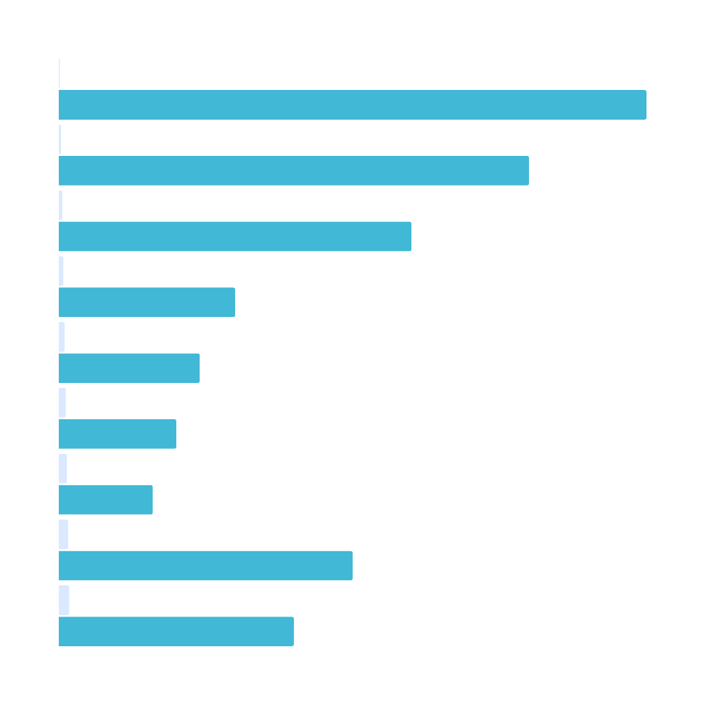
Let’s explore the data

Slide 6
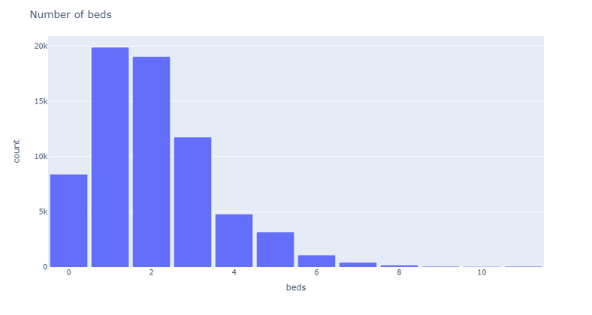
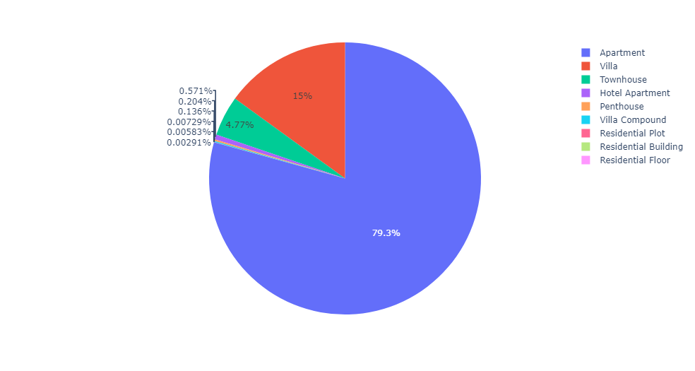
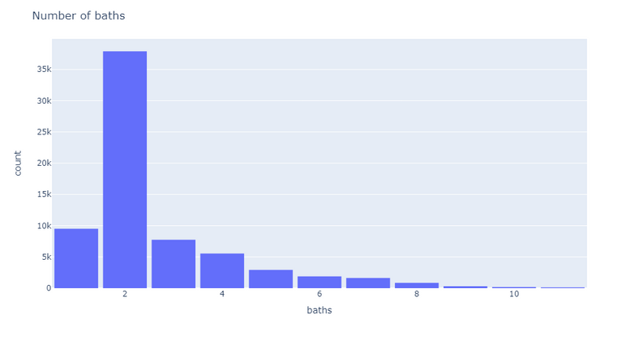
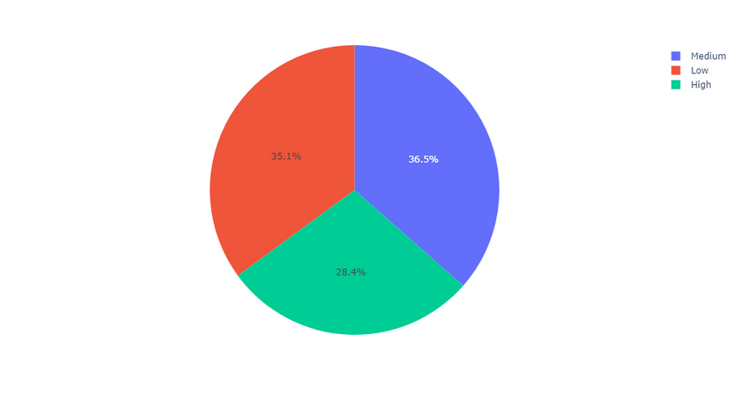
BUILDING PROPERTIES
number of bed rooms
the type of the building
number of bath rooms
rent category

Slide 7
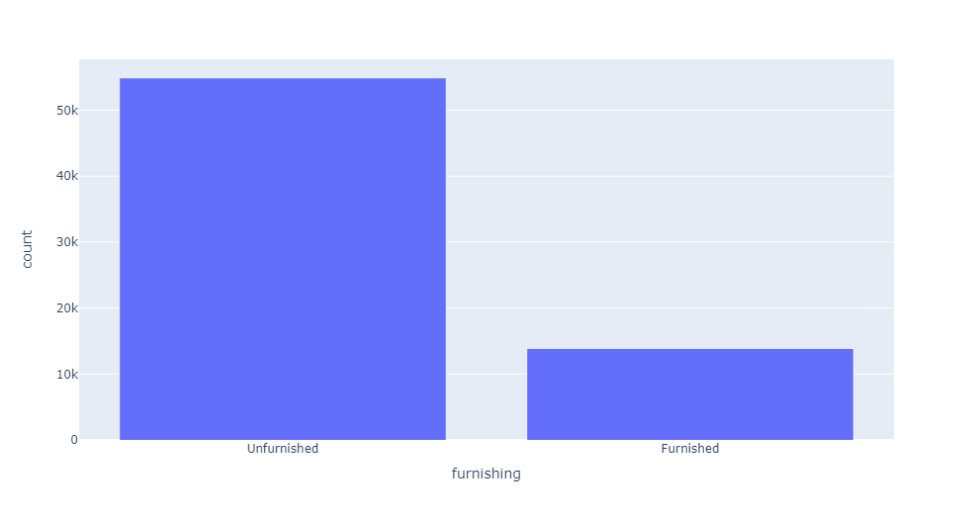
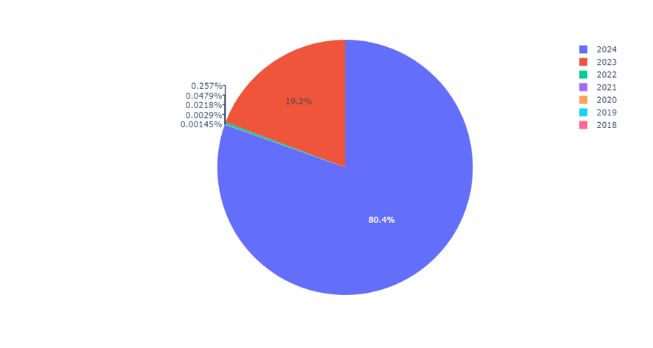
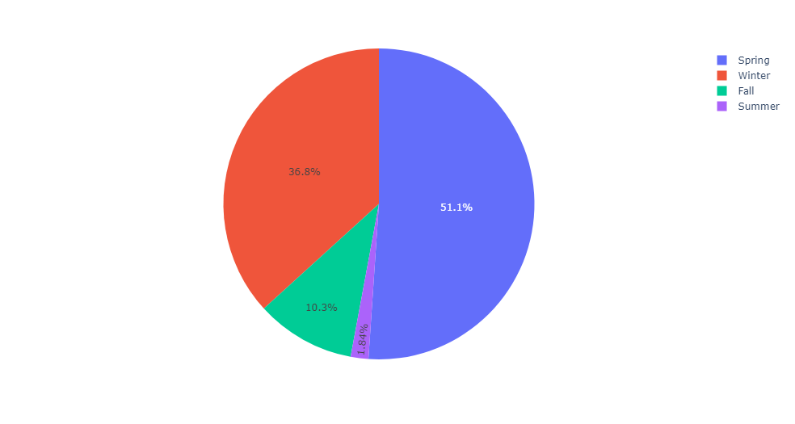
Furnishing
Years
Season

Slide 8
INSIGHTS
The bulding with 1,2,3 bed rooms is the most popular
The bulding with 1,2 bath rooms is the most popular
The bulding of type Apartment and Villa is the most popular
most building is unfurnishing
and most building is in Spring and winter seasons

Slide 9
Rent according to factors 2023 &2024

Slide 10
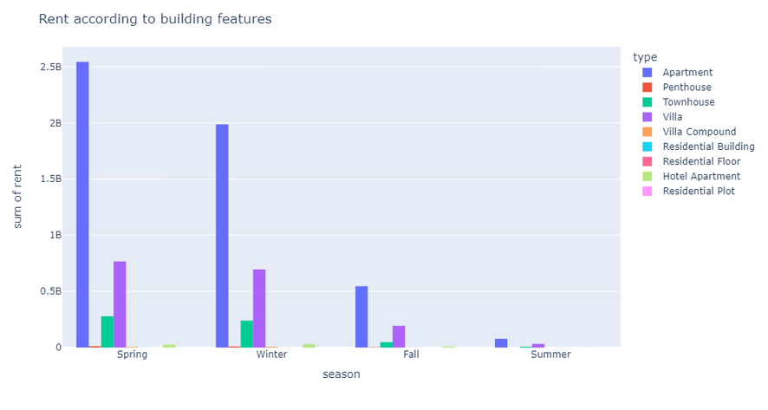
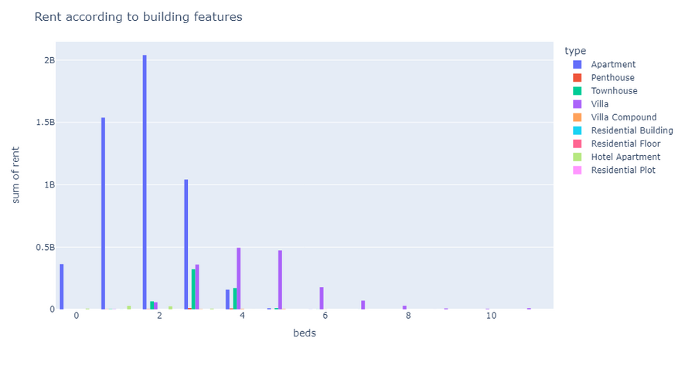
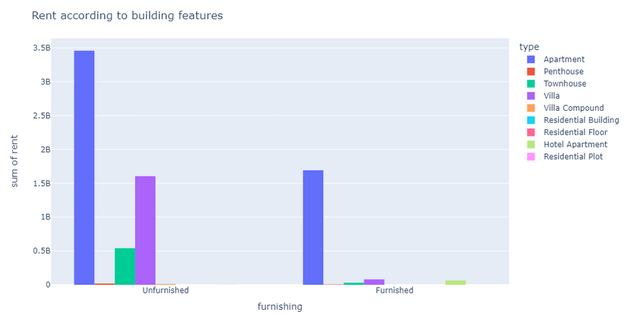
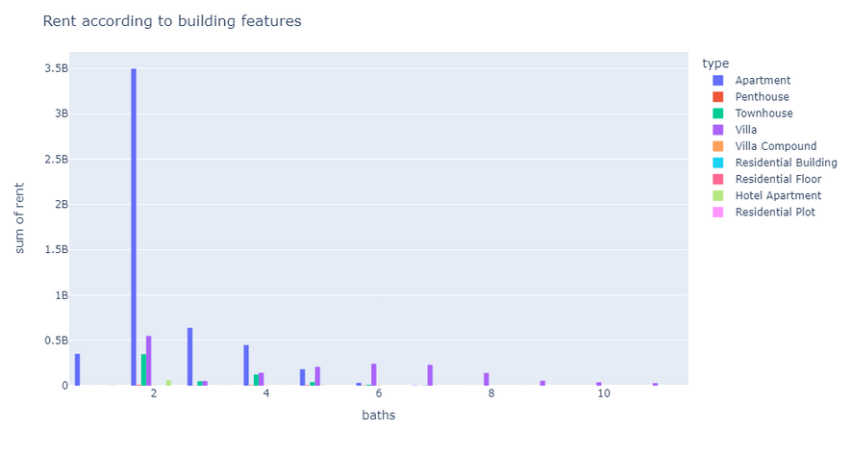

Slide 11
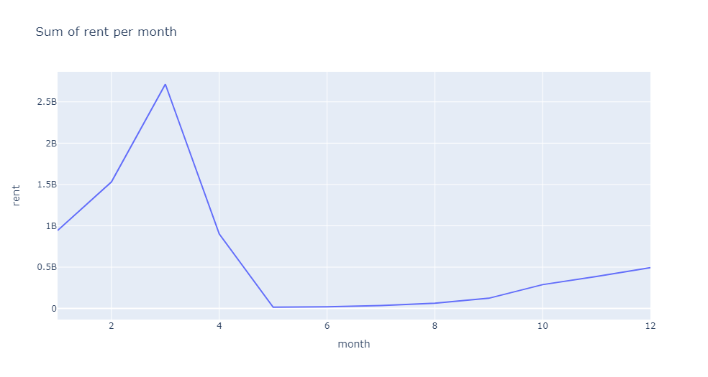
RENT PER MONTH

Slide 12
INSIGHTS
Apartment get’s the highest rent 2.5B specially in spring and winter season’s
Villa with rent more than 0.5B also in spring and winter
The Apartment with 1,2,3 bed rooms get rent in range 1B : 2B & Aparrtment with 2 bed rooms is the highest one with rent more than 2.5B
Villa with 3,4,5 bed rooms get rent start from less than 0.5B tell 0.5B & Villa with 4 bed rooms get 0.5B
Apartment and Villa with 2 bath rooms have rent 3.5B
march march get the highest rent more than 2.5B

Slide 13
compare years 2023& 2024 in type Aparment and villa in spring and winter seasons

Slide 14
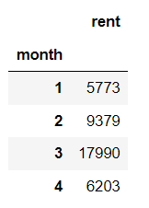
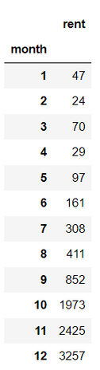
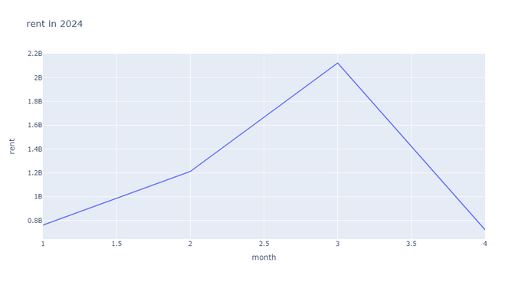
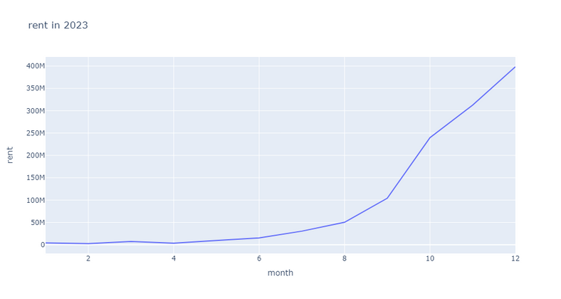
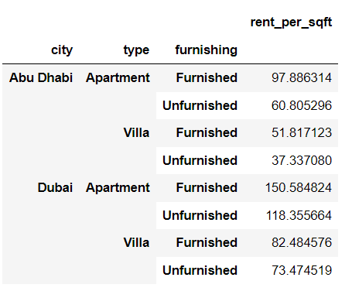
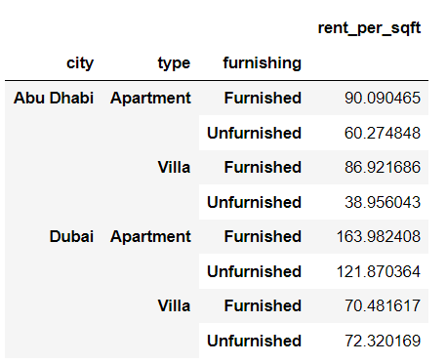
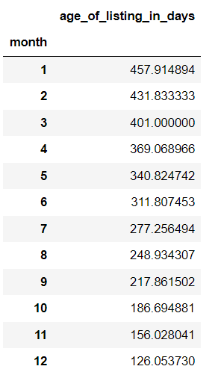
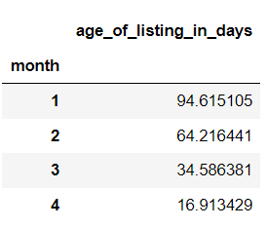
compare between 2023 & 2024
2024
2023

Slide 15
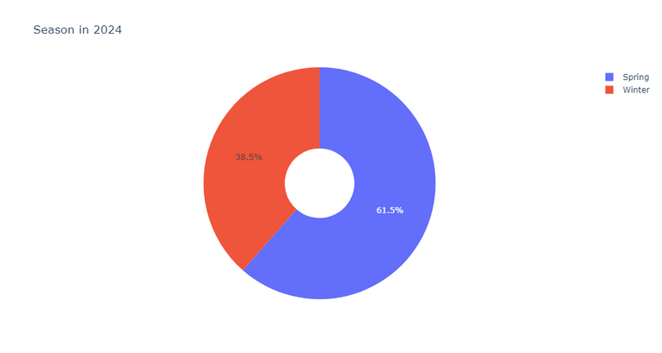
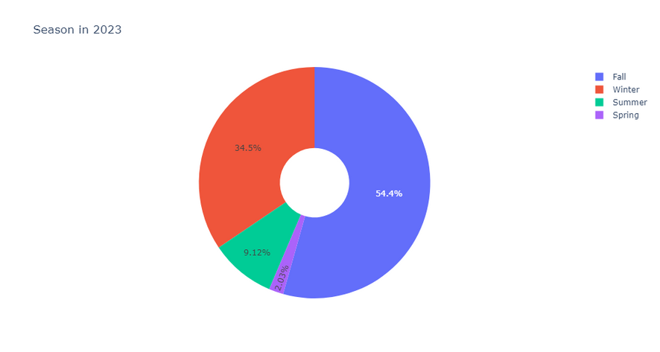
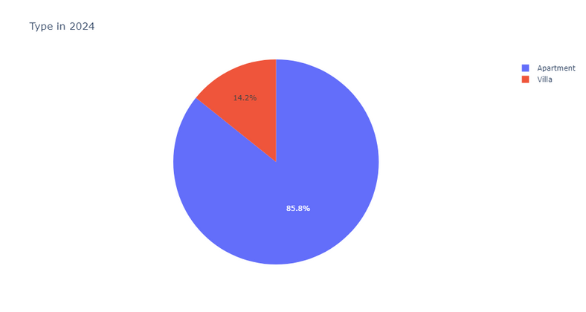
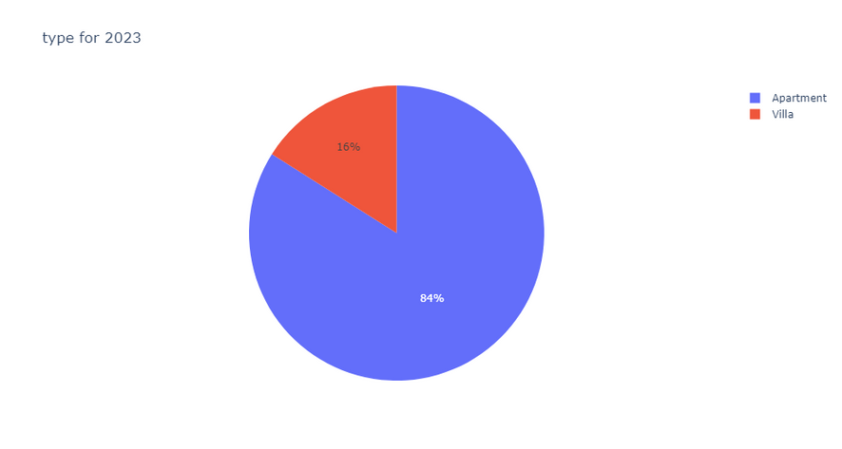
compare between 2023 & 2024
2024
2023

Slide 16
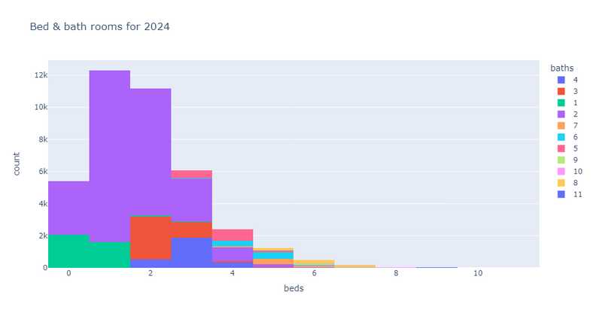
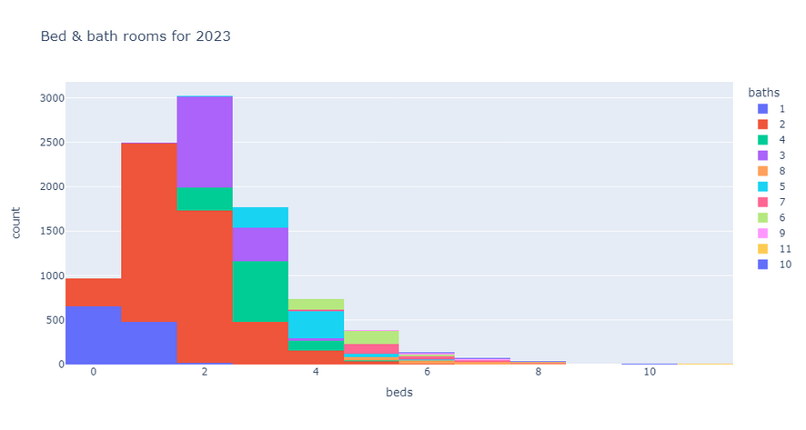
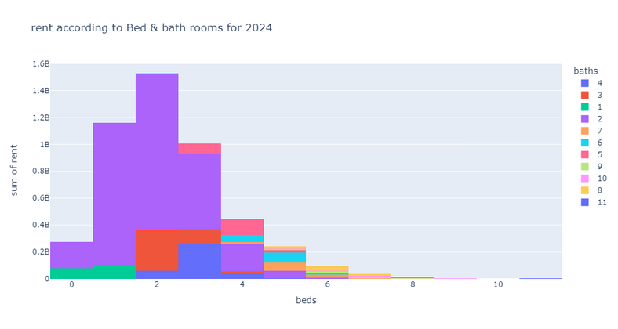
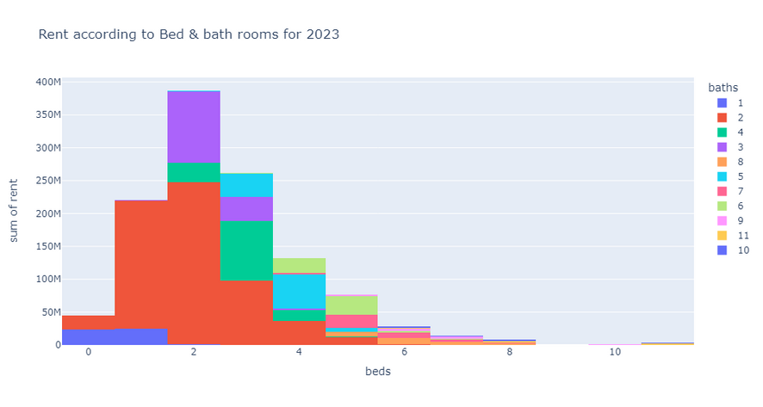
compare between 2023 & 2024
2024
2023

Slide 17
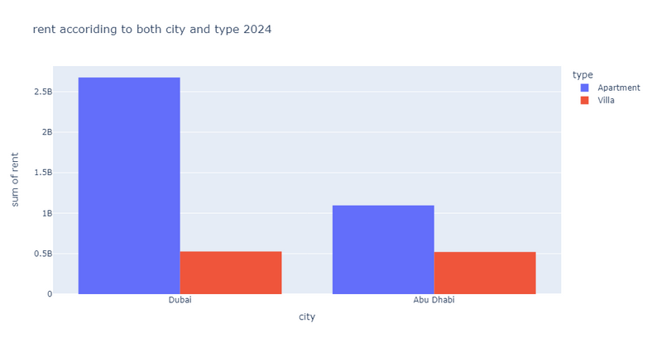
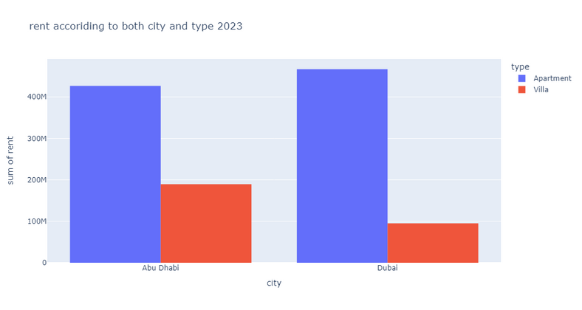
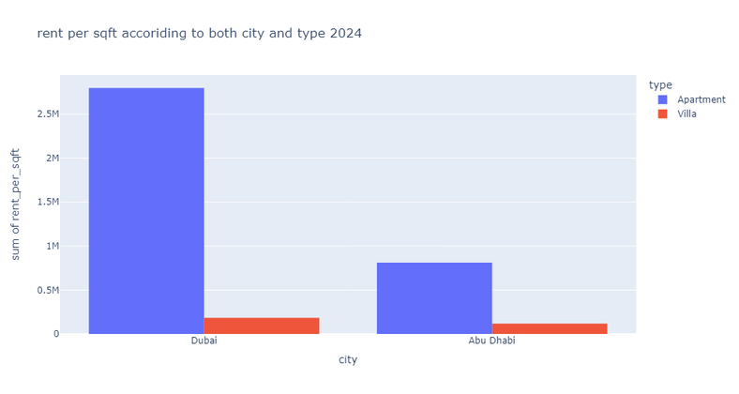
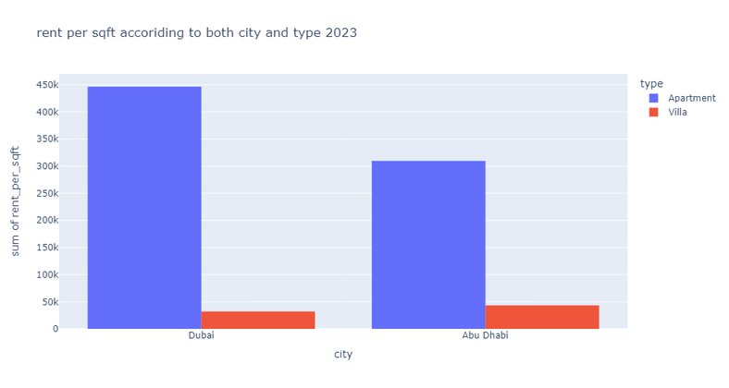
compare between 2023 & 2024
2024
2023

Slide 18
INSIGHTS
2024
March in 2024 is the month with high rent equal to 2.2B as their is 179990 builds rented and it’s average listing days is 17
The average rent per sqft for unfurnished apartment in Abu Dahabi is 60.80 and for furnished is 97.88 While unfurnished villa is 37.37 and furnished villa is 51
The average rent per sqft for unfurnished apartment in Dubai is 118.3 and for furnished is 150.5 While unfurnished villa is 73 and furnished villa is 82
2023
Dec in 2023 is the month with high rent equal to 420M as their is 3257 builds rented and it’s average listing days is 127
The average rent per sqft for unfurnished apartment in Abu Dahabi is 60.27 and for furnished is 90 While unfurnished villa is 39 and furnished villa is 86
The average rent per sqft for unfurnished apartment in Dubai is 121.8 and for furnished is 163.9 While unfurnished villa is 72.3 and furnished villa is 70.4

Slide 19
SUGGESTIONS
Invest in apartments in range 1,2,3 beds more than villa specially apartment with 2 beds and 2 baths.
if we will invest in villa make sure it’s with 3,4,5 bed rooms specially 4 and 2 baths and this for long term income compared with apartment.
always list large number of builds speacially apartments and villa in Dubai and Abu Dahabi in Spring and Winter seasons.
work with unfurnished builds
study the market in Ajman', 'Al Ain', 'Fujairah', 'Ras Al Khaimah', 'Sharjah', 'Umm Al Quwain' to open new market
collect data for summer and fall to study the market

